Slide 1

DEPARTMENT OF COMPUTER ENGINEERING, MODELING, ELECTRONICS AND SYSTEM ENGINEERING LM-Telecommunication Engineering: Smart Sensing, Computing and Networking Networking Aspects for IOT
Title: Smart Home IOT Project
Group Members Matricola
1. GEBRE HALEFOM MERESA 251897
2. MATTHIAS GODEBO JARSO 252664
1

Slide 2

Contents 1. Introduction 2. Project Objectives 3. System Overview 4. Block Diagram 5. Control Logics 6. Hardware and Components 7. System Workflow 8. Implementation and Result 9. Future Enhancement 10. Conclusion

Slide 3
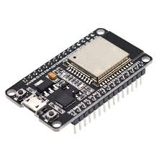
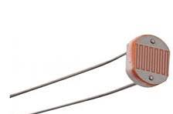
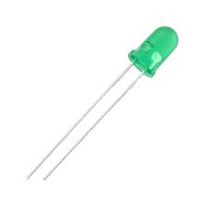
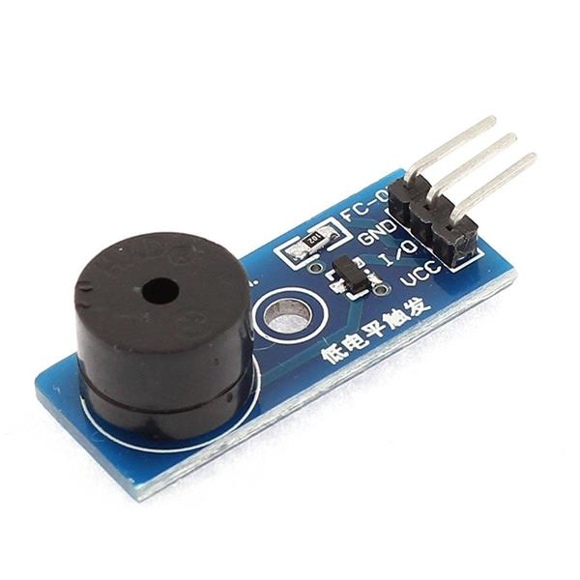
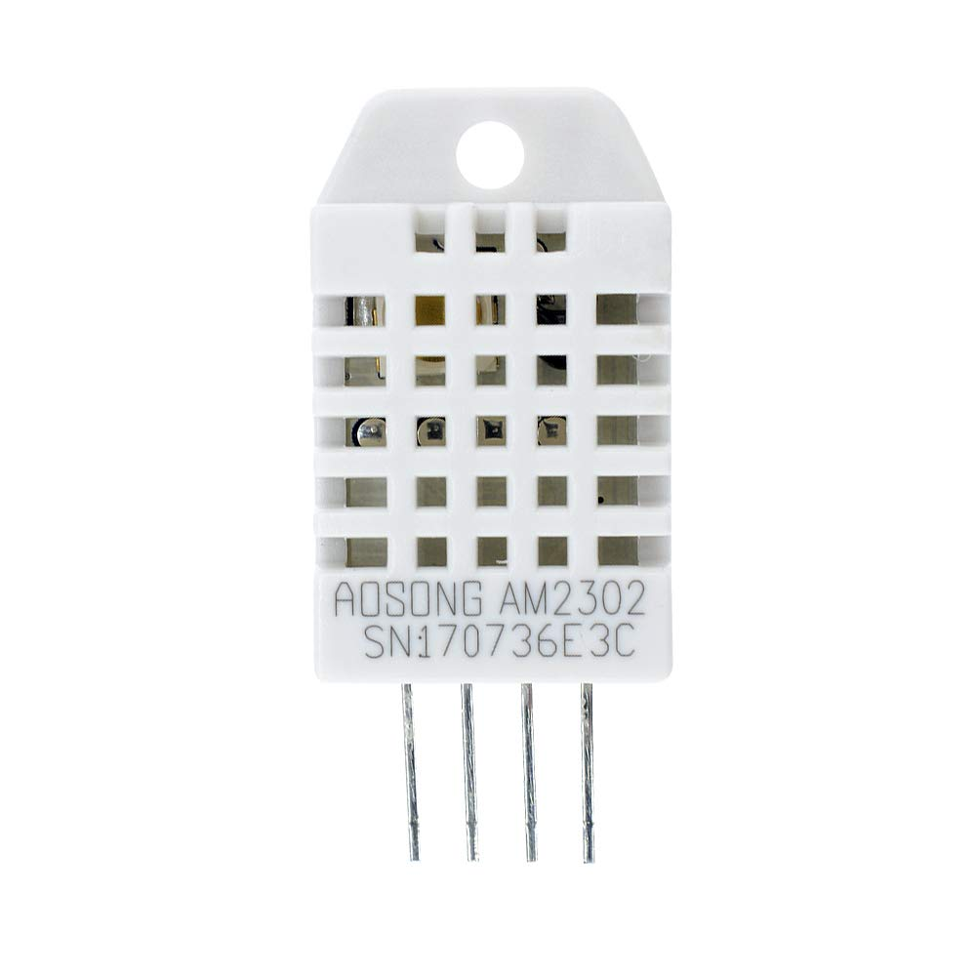
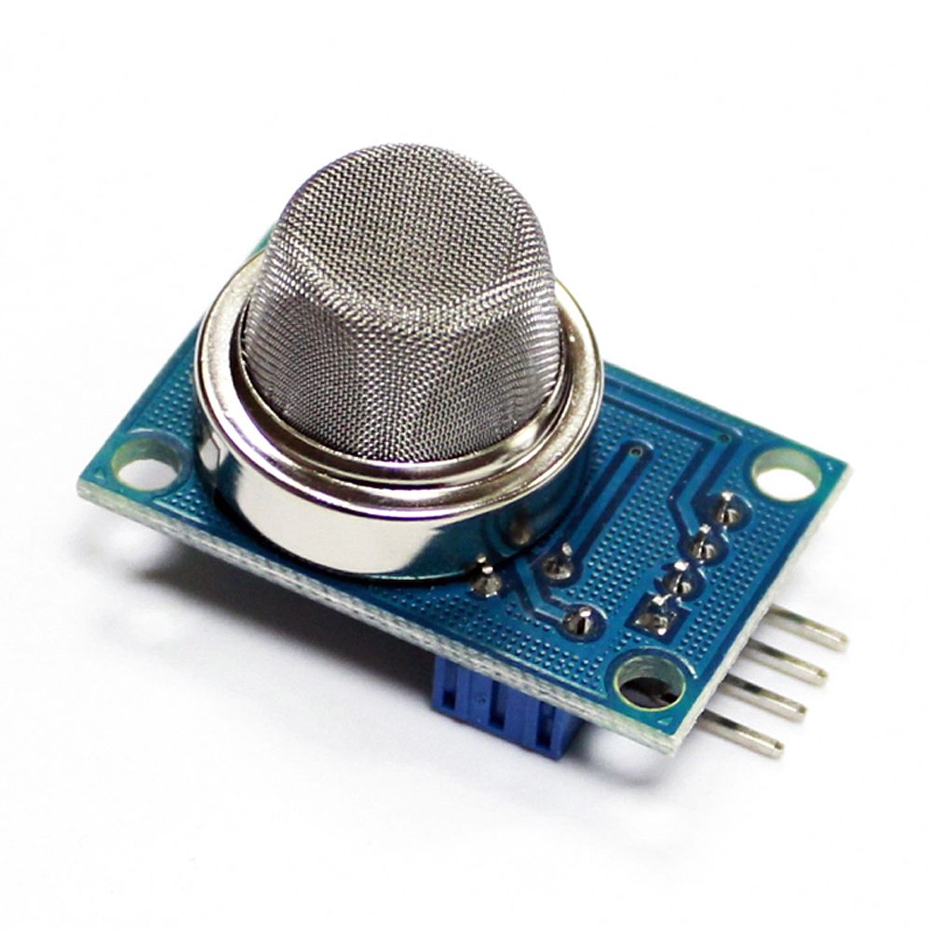
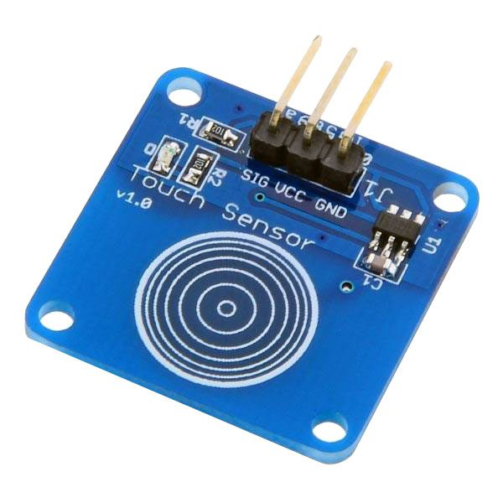
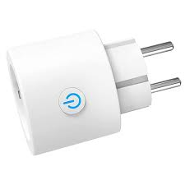
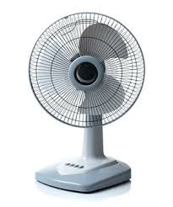
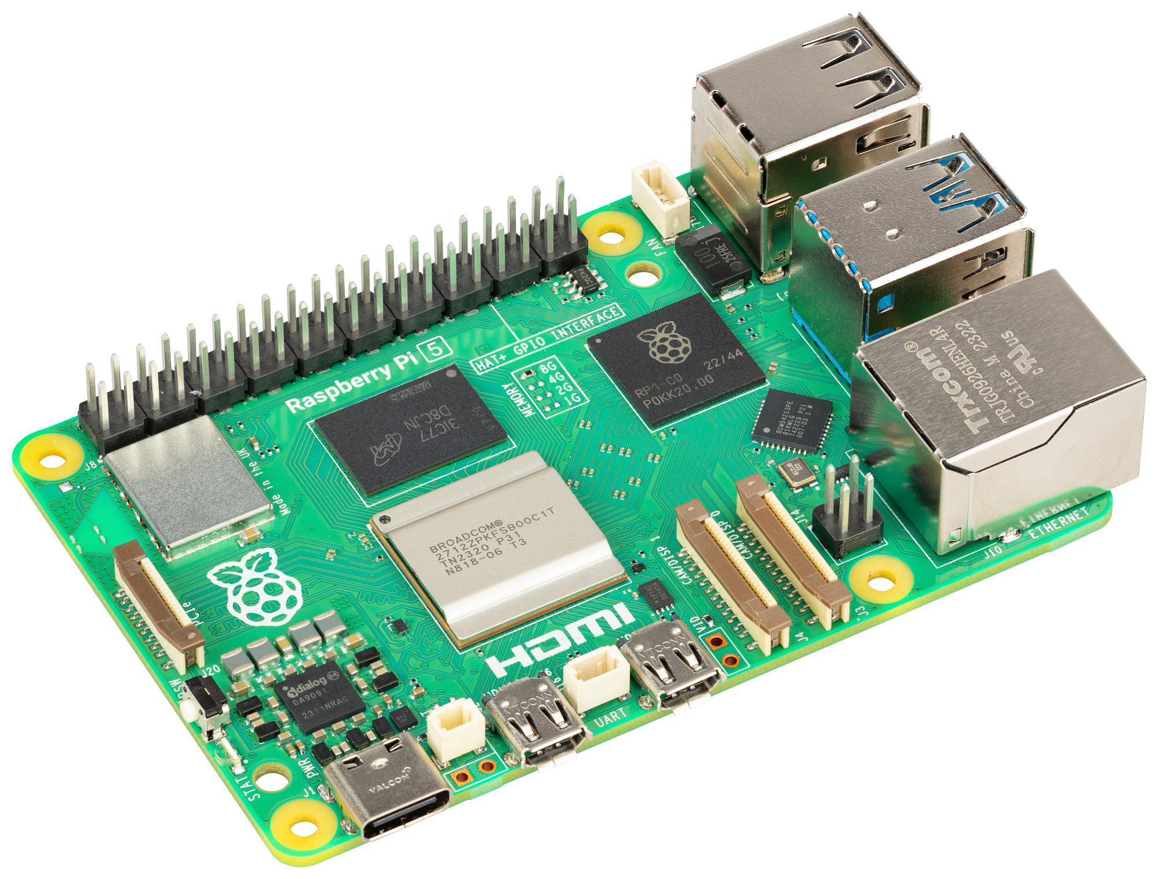
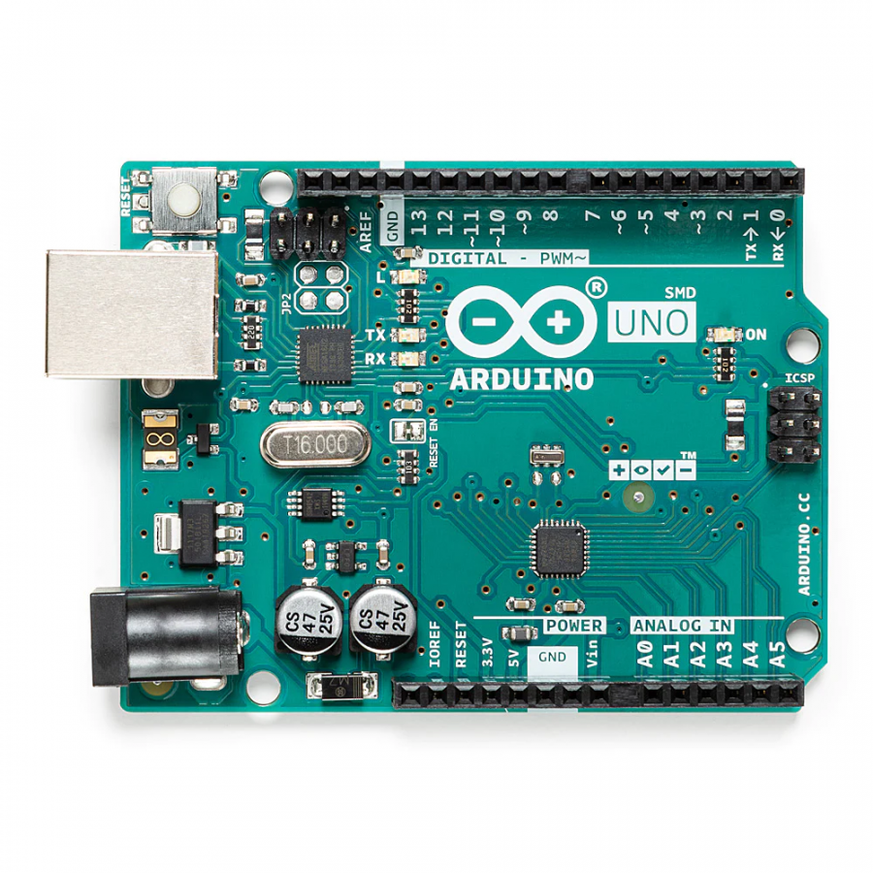
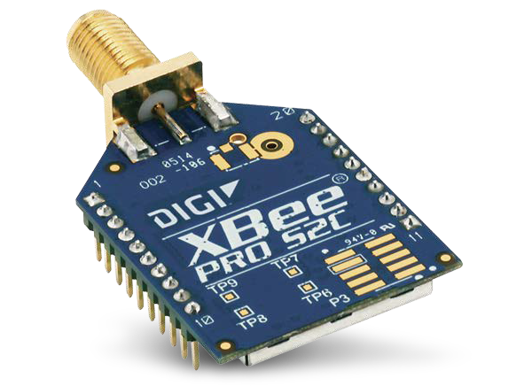
Introduction
ESP8266
Buzzer
LDR Sensor
DHT22 Sensor
Bulb
Touch sensor
Smoke sensor
Smart Plug
Fan
This project introduces a Smart Home IOT project using sensors, actuating devices and AWS cloud services .
Raspberry Pi
Arduino board
Xbee module

Slide 4




…Cont’d
Our project also utilizes ZigBee, Wi-Fi and MQTT protocols, and AWS Cloud Services to create a comprehensive smart home system.
AWS Services

Slide 5
Project Objectives
Fan Control: Automate fan operation based on given conditions.
Lighting Automation: Use an LDR sensor to control lighting based on ambient light levels, ensuring lights are only used when necessary.
Smoke Detection & Alerts: Integrate a smoke sensor to detect potential smoke hazards and trigger alert and notifications to the homeowner.
Real-Time Notifications: Utilize AWS IoT Core and AWS Lambda to send alerts via email when critical events like smoke or high temperature are detected.

Slide 6
System Overview
Architecture: The system integrates sensors (temperature, light, smoke, and touch) with actuators (fan, lights, buzzer) controlled by microcontrollers (ESP8266, Arduino, Raspberry Pi).
Data Flow: Sensor data is collected, processed locally on the Raspberry Pi, and transmitted to AWS IoT Core for real-time monitoring and alerts.
Control Logic: Appliances are controlled automatically based on sensor data, with key events triggering notifications via cloud services.

Slide 7
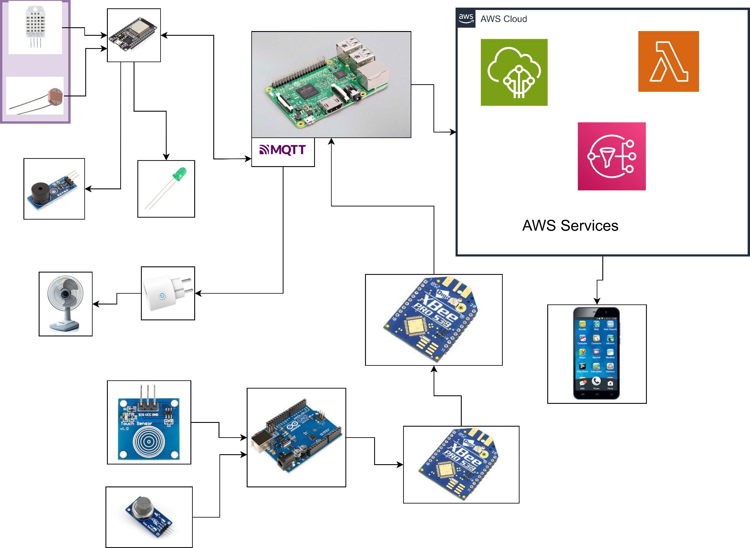
Block Diagram

Slide 8
Control Logics
Touch | Smoke | Buzzer
0 | 0 | 0
0 | 1 | 1
1 | 0 | 1
1 | 1 | 1
Touch | Smoke | LDR | Bulb
0 | 0 | 0 | 1
0 | 0 | 1 | 0
0 | 1 | 0 | 1
0 | 1 | 1 | 0
1 | 0 | 0 | 1
1 | 0 | 1 | 0
1 | 1 | 0 | 1
1 | 1 | 1 | 0
DHT (Temperature) | Smoke | Fan
0 | 0 | 0
0 | 1 | 1
1 | 0 | 1
1 | 1 | 1

Slide 9
Hardware Components
Sensors:
DHT22: Monitors temperature and humidity of the home.
LDR: Measures ambient light to control lighting.
Smoke Sensor: Detects smoke for safety alerts.
Touch Sensor: Used for doorbell.
Microcontrollers:
ESP8266: Handles communication for temperature and light sensors via Wi-Fi.
Arduino UNO: Manages data from smoke and touch sensors via Zigbee.
Raspberry Pi: Central hub that processes data and controls actuators.
Actuators:
Bulb :changes state based on light intensity.
Smart Plug: Controls fan via Wi-Fi.
Buzzer: Triggers alarms during smoke and doorbell detection.

Slide 10
Software Components
Arduino IDE: Programming environment used to code sensor and actuator interactions using C++.
Python (on Raspberry Pi): Python scripts process data locally, controlling appliances and communicating with AWS IoT Core.
AWS IoT Core: Manages the cloud-based storage and real-time monitoring of sensor data.
AWS Lambda: Executes functions when certain conditions are met, such as sending alerts through SNS during a critical event (e.g., smoke detection).

Slide 11
System Workflow
Data Collection: Sensors collect environmental data (temperature, light intensity, smoke, touch) and send it to the Raspberry Pi via ESP8266 (Wi-Fi) or Arduino (Zigbee).
Local Processing: The Raspberry Pi processes the data and triggers actions based on predefined rules.
Automation: Appliances respond in real time to changes in the home status based on sensor inputs.
Cloud Communication: Data is sent to AWS IoT Core for real-time monitoring and storage. AWS Lambda functions send notifications when critical conditions are met.

Slide 12
Cloud Integration
AWS IoT Core: Subscribes a topic from raspberry pi and trigger other AWS services in the cloud.
AWS Lambda: Executes automatic actions like sending alerts via SNS when critical conditions are detected (e.g., smoke or high temperature).
AWS SNS: Sends notifications via email or SMS to the homeowner in case of emergencies.
AWS DynamoDB: Stores sensors data.

Slide 13
Implementation & Results
Successful Tests: Fan, light, and buzzer control functions were successfully implemented.

Slide 14
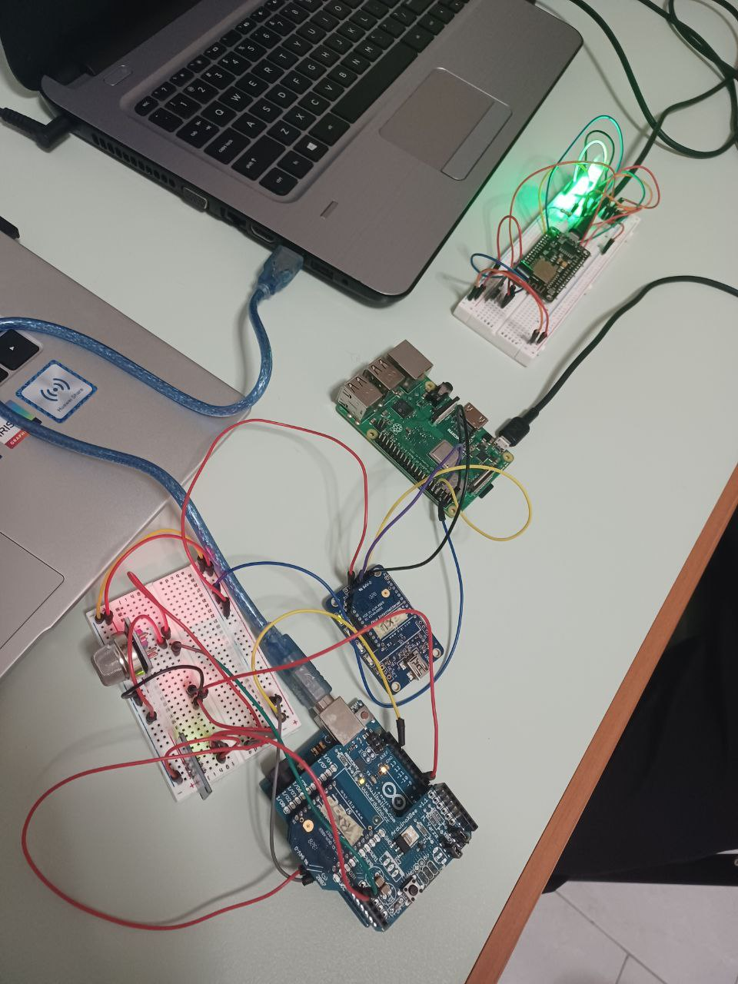
…cont’d

Slide 15
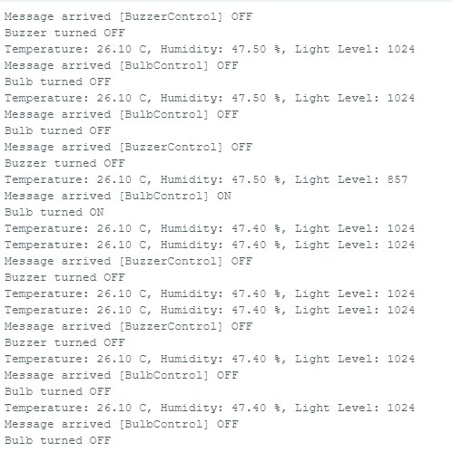
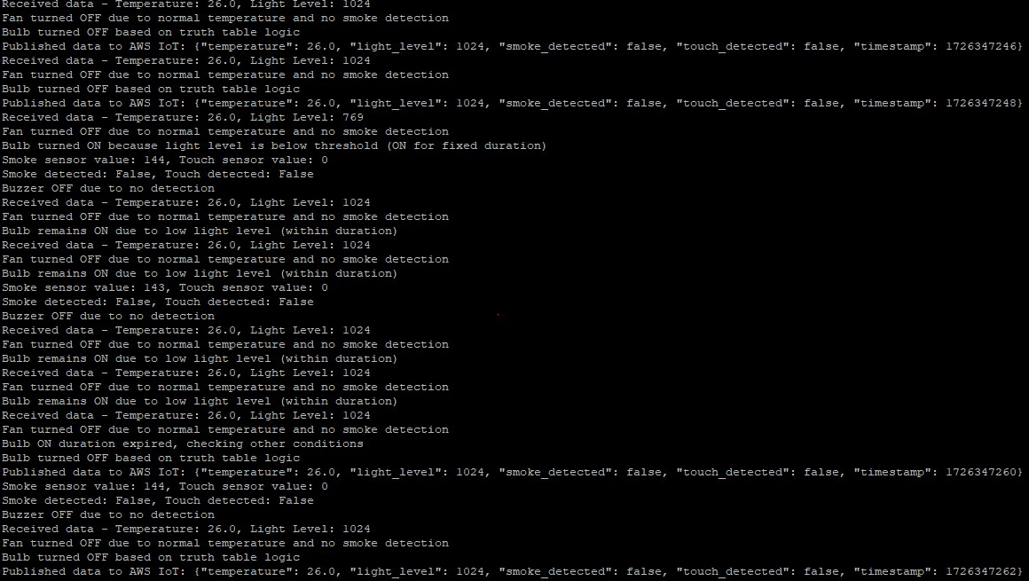
…cont’d
.

Slide 16
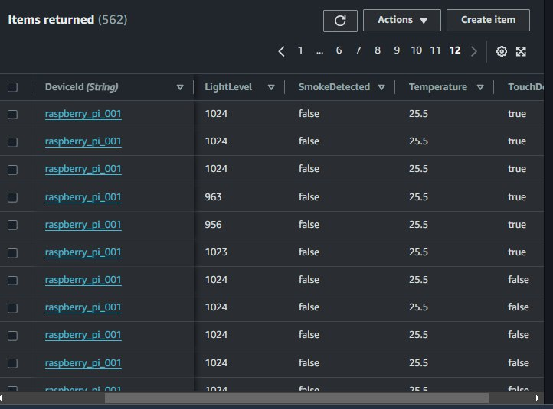
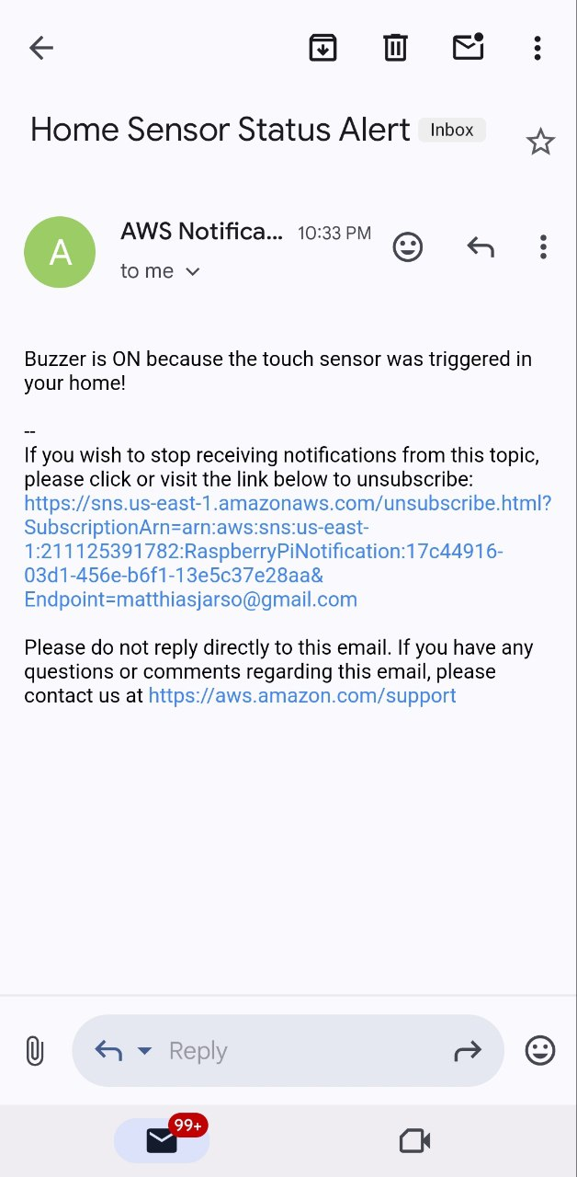
…cont’d
.

Slide 17
Challenges & Limitations
Response Delay: Noticed slight delay between the sensors and actuator responses, especially with lighting and touch sensor.
Sensor Interference: Interference between smoke and touch sensors led to prioritizing smoke alerts.
Scope Limitations: The system is limited to controlling specific appliances and does not cover all aspects of home automation.

Slide 18
…Cont’d
Xbee modules configuration mismatch
CoAP protocol challenge(error rate and data loss).
Control command from the cloud replaced by edge server (raspberry pi),which reduces latency.
Topology change
Power consumption

Slide 19
Future Enhancements
Expand Appliance Control: Integrate more devices like door locks and security cameras.
Improve Sensor Accuracy: Add redundancy for critical sensors to reduce interference and improve accuracy.
Explore Alternative Communication Protocols: Experiment with Bluetooth, LoRa, or other protocols to further reduce latency and improve reliability.
Introducing machine learning model which learns from the sensor data using AWS SageMaker.
Android Application for remote control

Slide 20
Conclusion
Summary: Successfully automated the control of home appliances using sensors, microcontrollers, and cloud services based on certain conditions.
Potential: The project opens up possibilities for expanding smart home automation with more advanced technologies.

Slide 21
.
Thank you !!!!!!

